Slide 1

Customer Segmentation
Team Indigo

Slide 2
Business Objective:
Increase conversion rate of emails to purchases
KPI’s:
Email Conversion Rate: 75%
Total revenue Per segment
Number of customers per segment

Slide 3
How we Segmented our Customers
Used RFM segmentation
Ranked each section 1-5
Recency - the date of a customers last order
Frequency - the total number of transactions per customer
Monetary - total revenue generated per customer
Assumptions:
Only included those who opted in to emails

Slide 4
RFM Rankings
Recency
Frequency
Monetary
R | Recency | Description
5 | 1st 20% | Most recent
4 | 2nd 20% | Relatively recent
3 | 3rd 20% | Somewhat recent
2 | 4th 20% | Less recent
1 | 5th 20% | Not recent
F | Frequency | Description
5 | Top 5% | Most frequent
4 | Top 20% | Relatively frequent
3 | Top 30% | Somewhat frequent
2 | Top 60% | Less frequent
1 | Bottom | Not frequent
M | Monetary | Description
5 | Top 5% | Most money
4 | Top 20% | High money
3 | Top 30% | Medium money
2 | Top 60% | Low money
1 | Bottom | Lowest money

Slide 5
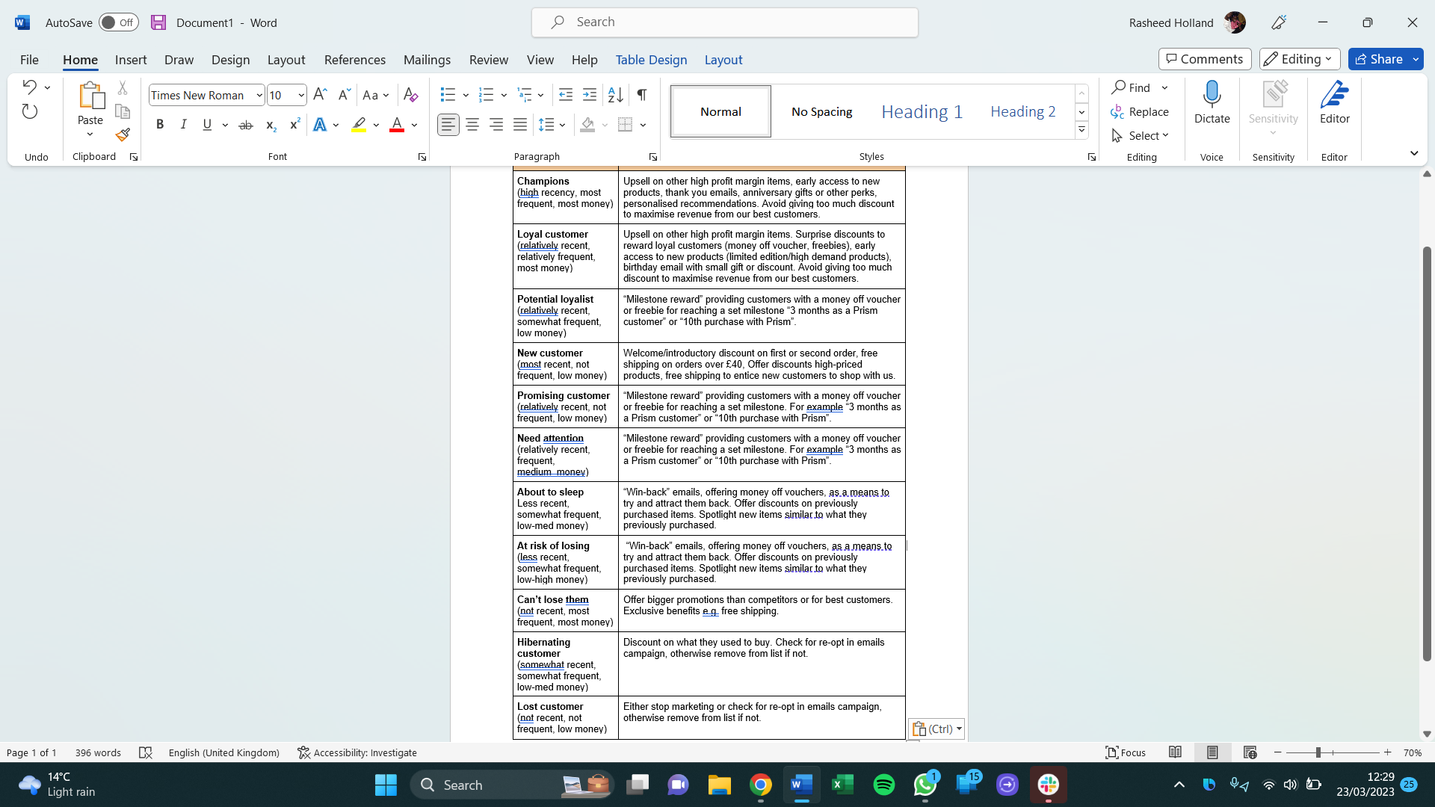
Our Segments
Notes:
Based on RFM score, customer base is divided into 11 segments
Identified the most loyal customers, the occasional shoppers and those who might need an incentive to return
Assist in showing the churn rate

Slide 6
Potential Marketing Strategies per Segment
Top bracket
Middle bracket
Low bracket
Notes:
Marketing campaigns would need to be adapted to keep existing customers returning and entice new and occasional shoppers
As the focus is on email conversion rate, the segments will receive different marketing emails
Tailor the content of the email, as well as rewards to a customer’s ranking

Slide 7
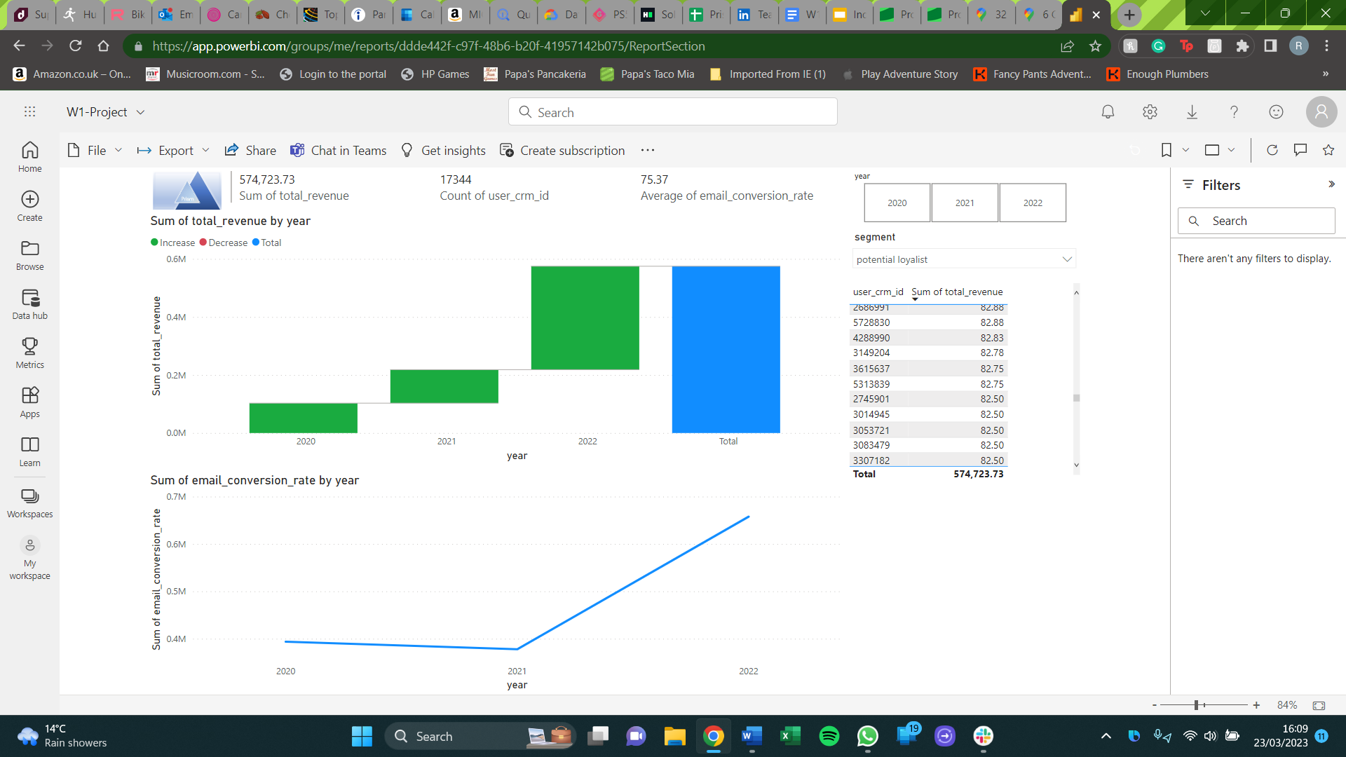
What Does the Data Say?
Notes:
Can see a correlation between email conversion rate and revenue
As one increases, the other also increases
However, unable to find out how the segments play a role in this
Is the increase influenced greater due to incentives granted to loyal customers or discounts provided to the less active ones
Email marketing has been highlighted as the most impactful

Slide 8
Summary
Increase Conversion rate of emails to purchases
Use recommendations as mentioned prior
Implements these by using A/B test to analyse the impact of personalising the emails vs. previous email marketing on email conversion rate
Power Bi Dashboard:
https://app.powerbi.com/groups/me/reports/ddde442f-c97f-48b6-b20f-41957142b075/ReportSection?clientSideAuth=0

